Slide 1


Key Takeaways
Sharpe Ratio, Maximum Drawdown and Stability of a Portfolio
Sharpe-optimized stable Portfolios
MDD-Optimized stable Portfolios
Exchange’s Market Health Index (MHI)
MHI based MDD-optimized stable Portfolios

Slide 2

Asset Allocation Strategies
Defining asset classes
Strategic vs. tactical asset allocation
Factors influencing asset allocation decisions
Implementing an effective asset allocation model
Photo by: Steve Johnson https://www.pexels.com/@steve

Slide 3
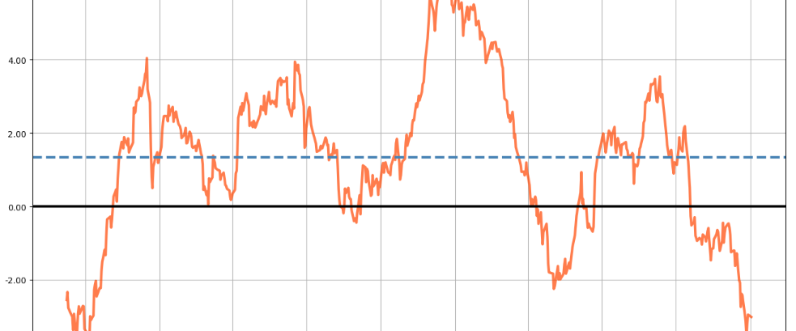
MHI Portfolios

Slide 4
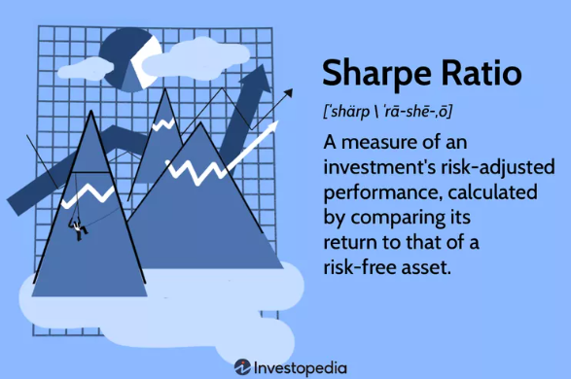
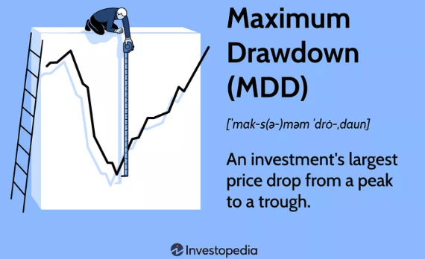
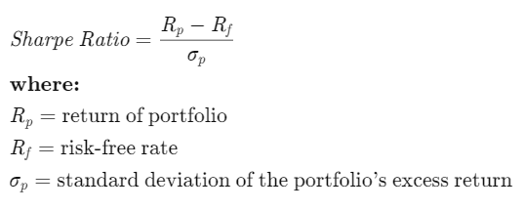

Definitions of portfolio performance parameters

Slide 5
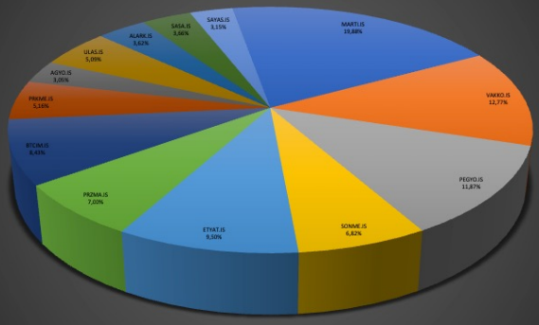
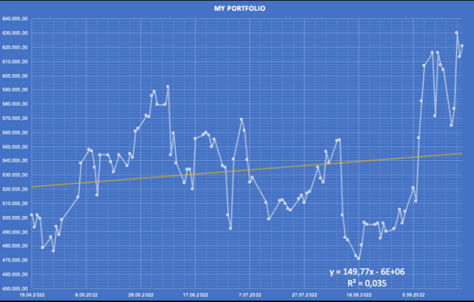
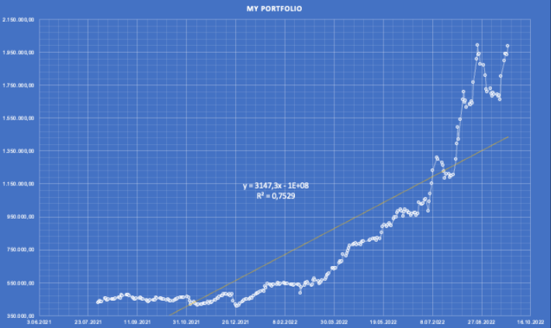
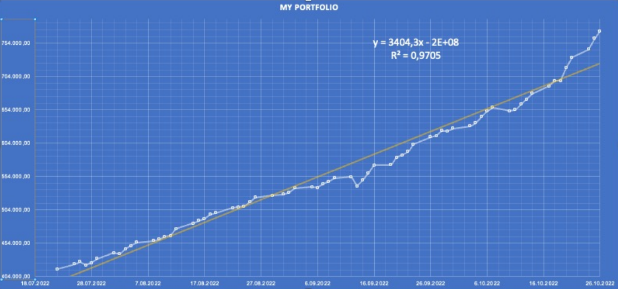
Performances of BIST Stock Exchange Portfolios
Single asset portfolio (8.5 months)
5-asset portfolio (4.5 months)
17- asset portfolio (4 months)
Returns = %23.4
Stability = %2.53
Sharpe = 1.23
MDD = - %20.4
Returns = %364
Stability = %85
Sharpe = 3.61
MDD = -16.5 %
Period Returns = % 87.6
Stability = %98.7
Sharpe = 16.5
MDD = -2.56 %

Slide 6
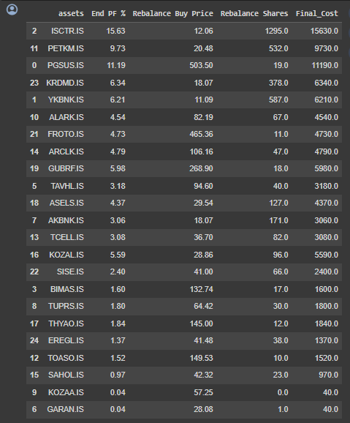
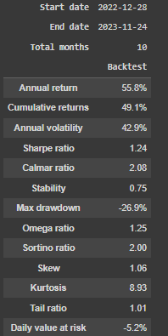
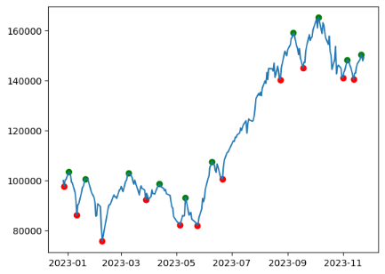
An optimized portfolio for 28.12.2022 – 24.12.2023

Slide 7
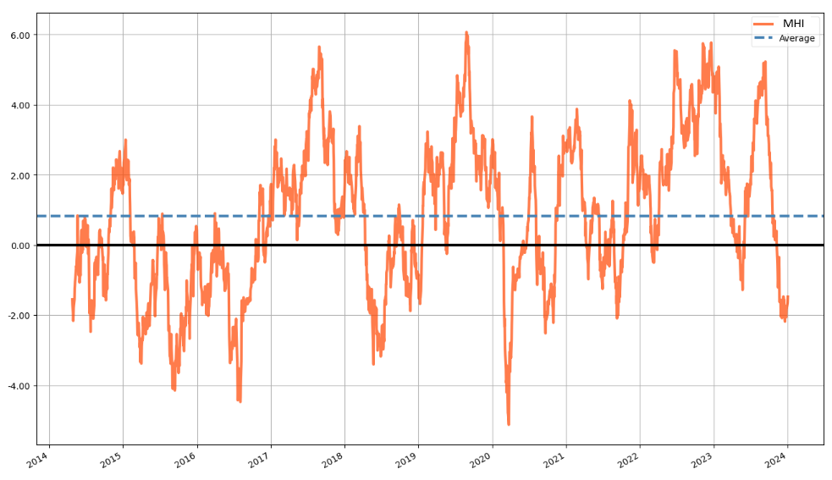
Market Health Index (MHI) for BIST30 - A mean-reverting index for trend detection

Slide 8
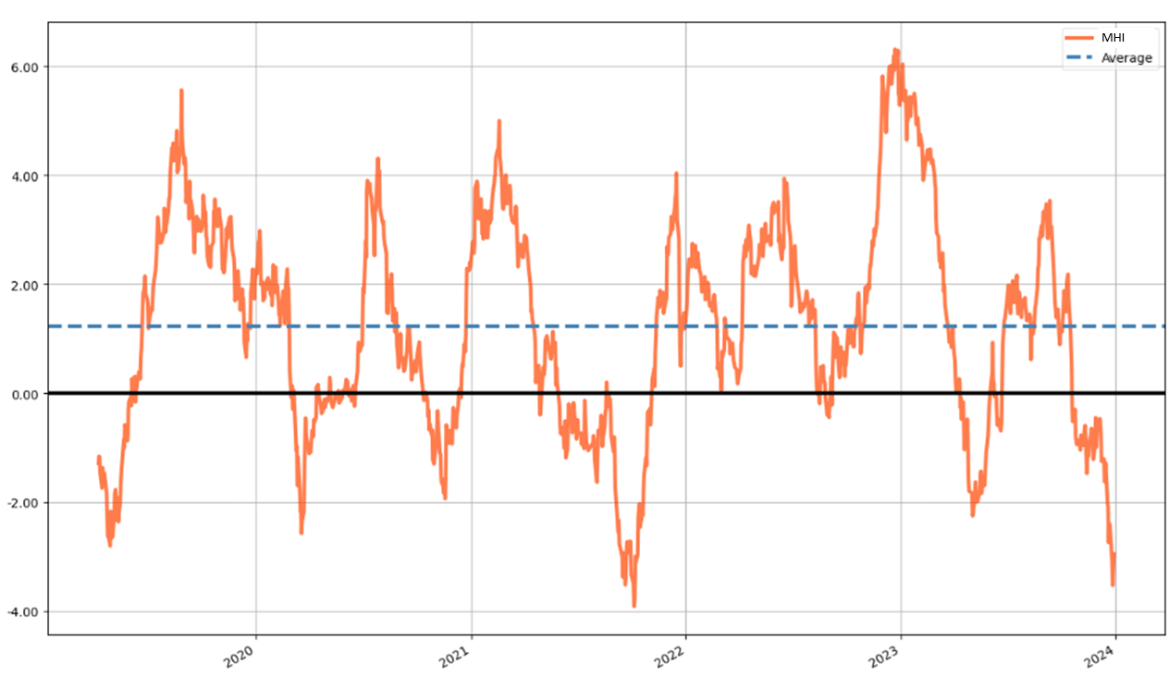
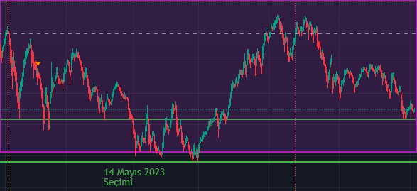
Market Health Index (MHI) - A mean-reverting index for trend detection
MHI on BIST30
Downtrend Uptrend
PREV UPTREND
23.08.2021 – 21.09.2022 21.09.2021 – 16.12.2021 (I)
16.12.2021 – 24.02.2022 24.02.2022 – 07.06.2022 (II)
07.06.2022 – 16.08.2022 16.08.2022 – 27.12.2022 (III)
27.12.2022 – 09.05.2023 09.05.2023 – 11.09.2023 (IV)
11.09.2023 – 26.11.2023 NEXT UPTREND
BIST100 – last 1 year
Last 5 years >>

Slide 9
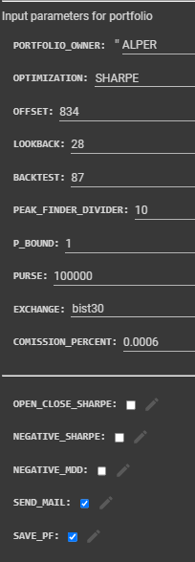
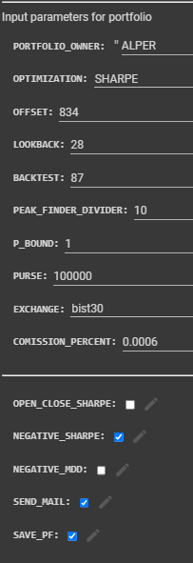
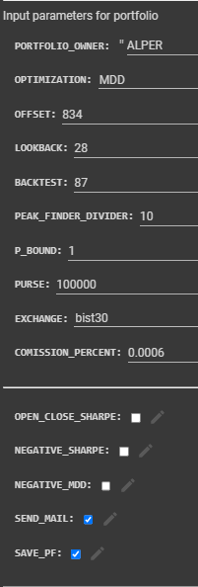
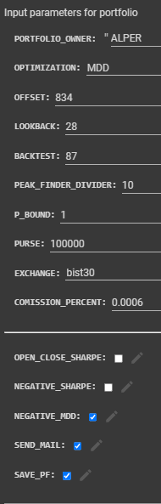
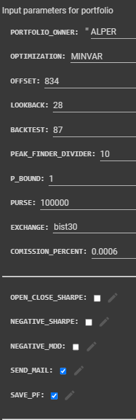
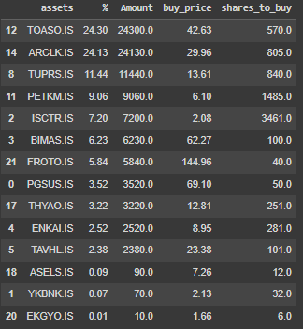

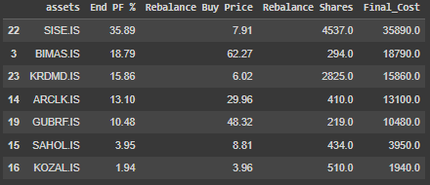

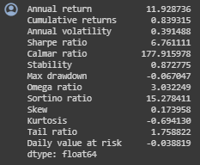
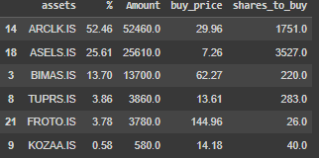
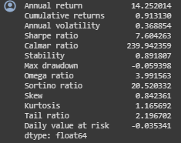
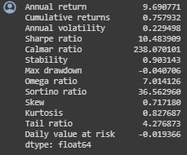
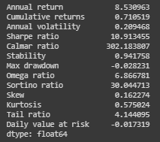
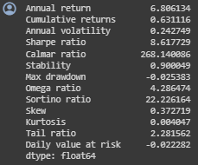
MHI portfolios for 21.09.2021 – 16.12.2021 (I)
Sharpe i-Sharpe MDD i-MDD MINVAR
Return: %91.3
SR: 7.6
MDD: %5.93
Return: %83.9
SR: 6.76
MDD: %6.7
Return: %75.8
SR: 10.48
MDD: %4
Return: %63.1
SR: 8.61
MDD: %2.53
Return: %71.1
SR: 10.91
MDD: %2.82

Slide 10
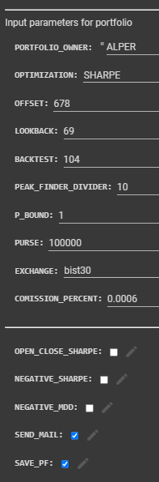
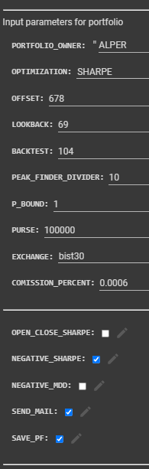
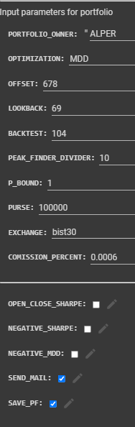
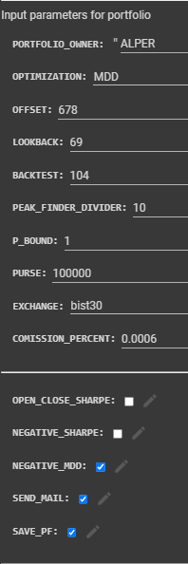
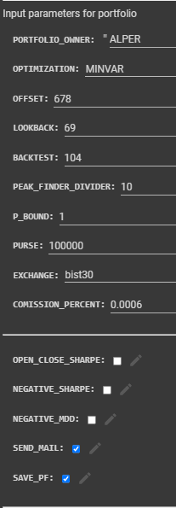

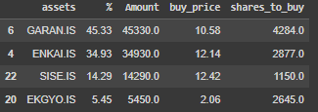


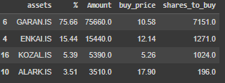
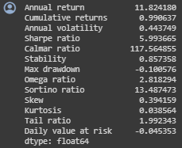
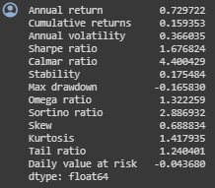
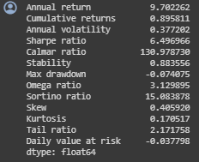
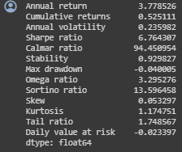
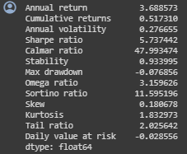
MHI portfolios for 24.02.2022 – 07.06.2022 (II)
Sharpe i-Sharpe MDD i-MDD MINVAR
Return: %99
SR: 5.99
MDD: %10.0
Return: %15.93
SR: 1.67
MDD: %16.58
Return: %89.6
SR: 6.49
MDD: %7.40
Return: %52.5
SR: 6.76
MDD: %4.0
Return: %51.7
SR: 5.73
MDD: %7.68

Slide 11
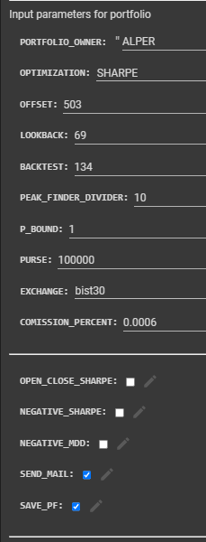
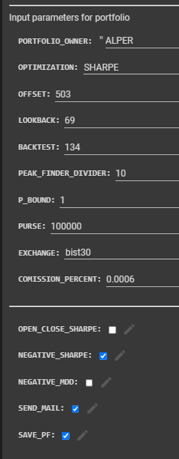
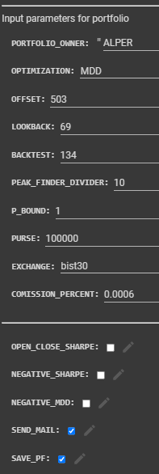
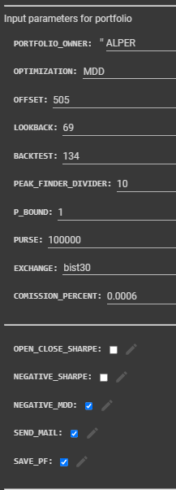
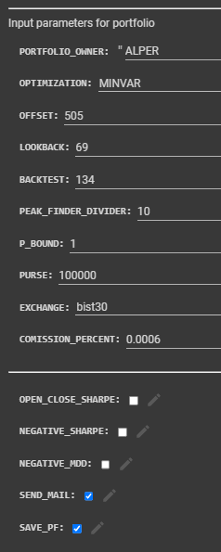
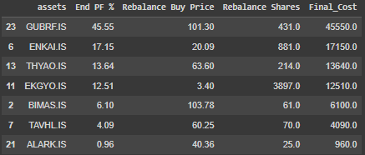
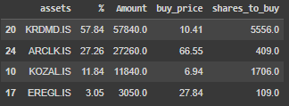
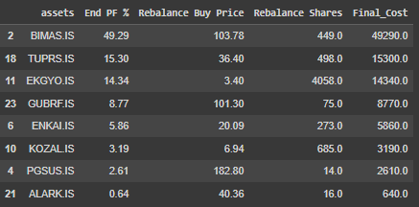

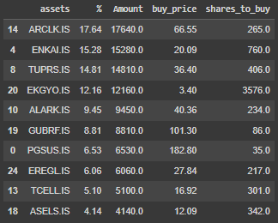
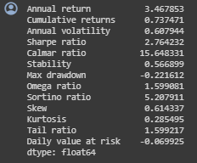
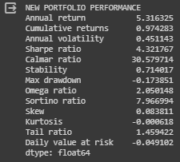



MHI portfolios for 16.08.2022 – 27.12.2022 (III)
Sharpe i-Sharpe MDD i-MDD MINVAR
Return: %73.7
SR: 2.76
MDD: %22.2
Return: %120
SR: 5.66
MDD: %7.2
Return: %97.4
SR: 4.32
MDD: %17.4
Return: %78.7
SR: 4.64
MDD: %9.9
Return: %95.5
SR: 5.96
MDD: %12.0

Slide 12















MHI portfolios for 09.05.2023 – 11.09.2023 (IV)
Sharpe i-Sharpe MDD i-MDD MINVAR
Return: %56.6
SR: 2.75
MDD: %13.7
Return: %65.6
SR: 3.39
MDD: %11.4
Return: %80.4
SR: 3.96
MDD: %16.1
Return: %64.3
SR: 3.96
MDD: %17.8
Return: %92.3
SR: 4.82
MDD: %12.4

Slide 13




Slide 14
Procedure for Portfolio Construction
Calculate and plot 5 year-MHI
Detect peaks (MHI > 4) and valleys (MHI < -2)
Apply Correlation filter
At the valleys, starting from latest peak calculate portfolio and enter that portfolio.
At the first peak, sell the portfolio.

Slide 15

Filter for Correlation

Slide 16

Filter for Volatility

Slide 17

Our B2B Product: AI optimized MHI Portfolios
AI assisted portfolio generation in Python with:
Entry exit based on MHI – mean reverting Market Health Index
Sharpe, i-Sharpe, MDD, i-MDD, MinVAR optimized
Correlation, volatility, fundamentals filter
To be added: KAP news filter
Consolidated returns
Customer Positioning:
Retail long-portfolio traders
Insurance banks
Retirees
QUESTIONS ?

Slide 18


